Slide 1


Telcomn Presentation
Title: "WAVECON: 5G Launch Impact Analysis"
Subtitle: " Insights and Strategic Recommendations"
Presenter: [AMAN VERMA]
Date: 15 Nov, 2024
Codebasics Virtual Internship Week-2 Task 4

Slide 2


About Wavecone
Wavecon, one of the leading telecom companies in India, launched its 5G services in May 2022.
This report analyzes data from January to April 2022, representing the period before the 5G launch.
It also includes data from June to September 2022, representing the period after the 5G launch.

Slide 3

Agenda
Impact of 5G Launch & Underperforming KPIs
Difference Between Active Users
Plan Performance: High and Low
Plans Affected or Discontinued Post-5G Launch
Strategic Insights and Recommendations
Q & A

Slide 4
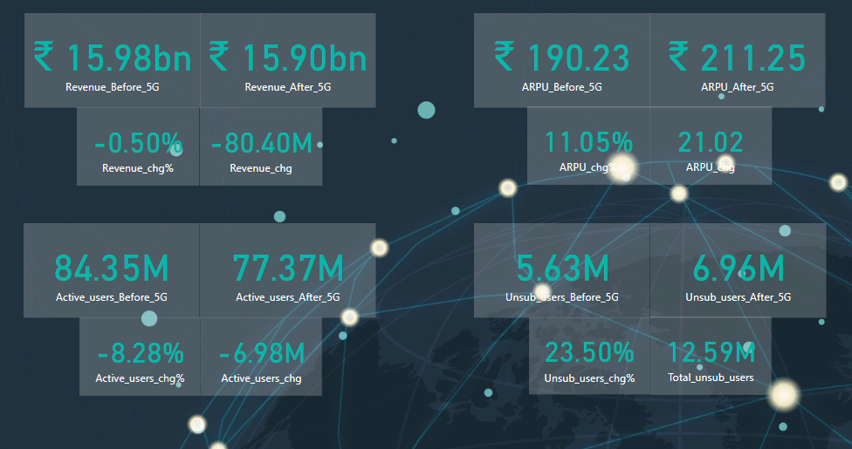
Impact of 5G Launch & Underperforming KPIs
Impact of 5G Launch & Underperforming KPIs
Average Revenue Per User (APRU)

Slide 5
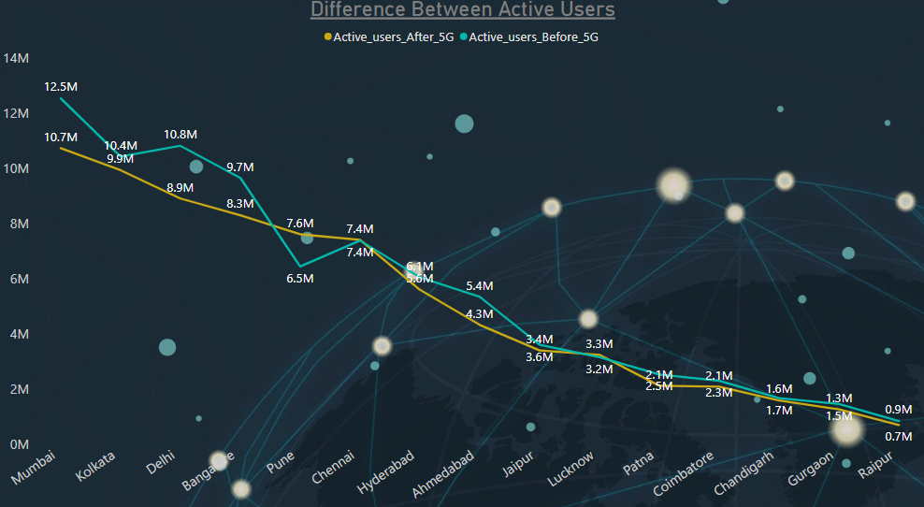
Active Users

Slide 6
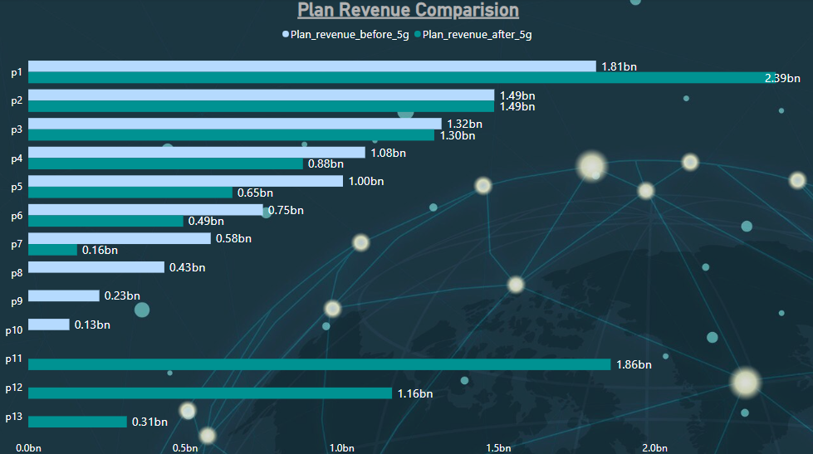
High-Performing & Underperforming Plans Post-5G Launch

Slide 7
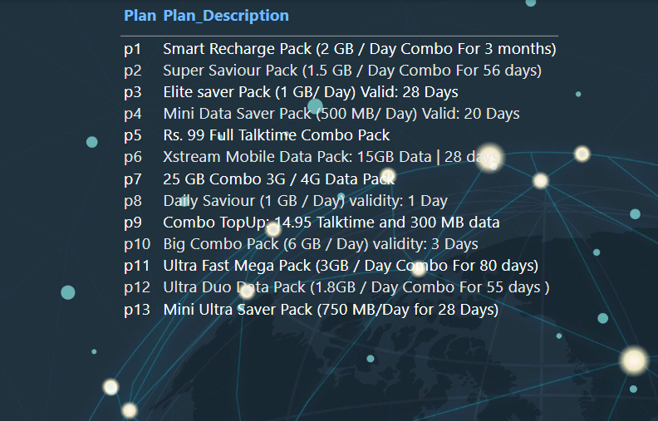
Plans Affected and Discontinued Post-5G Launch
The most significant increase in revenue is seen in P1.
P2 and P3 have remained stable.
P4, P5, P6, and P7 have seen a decline in revenue.
P8, P9, and P10 have not performed well.
P11, P12, and P13 are newly launched plans and their performance will be monitored closely

Slide 8

Strategic Recommendations
Partner with OTT platforms: Offer bundled deals to attract new subscribers and retain existing ones.
Targeted Marketing: Use data analytics to personalize offers and marketing campaigns.
Enhanced Customer Support: Provide 24/7 support and invest in AI-powered solutions.
Network Optimization: Continuously improve network performance and expand 5G coverage.
Innovative 5G Services: Explore new services like AR/VR and cloud gaming to drive user engagement.

Slide 9

Q & A
You can contact me via
Email: mailbox.amanvrma@gmail.com
LinkedIn: https://www.linkedin.com/in/aman-verma-insights/
See the live dashboard link to interact with the data.

